Slide 1
SDI FY18 Task 3 – Inverse Modeling in Model Calibration
2018-10-11

Slide 2
Task 3: Test the use of inversed models in the model calibration process
Workflow:
Identify an EnergyPlus model (a DOE reference model or a real building model)
Conduct traditional model calibration and record performance
Use the hybrid method in the calibration
3.1. Initial calibration using traditional approach
3.2. Run inversed models to determine unknown parameters
3.3. Use the calculated parameters from 3.2 in the traditional calibration and re-run it.
3.4. Repeat this process as needed.

Slide 3
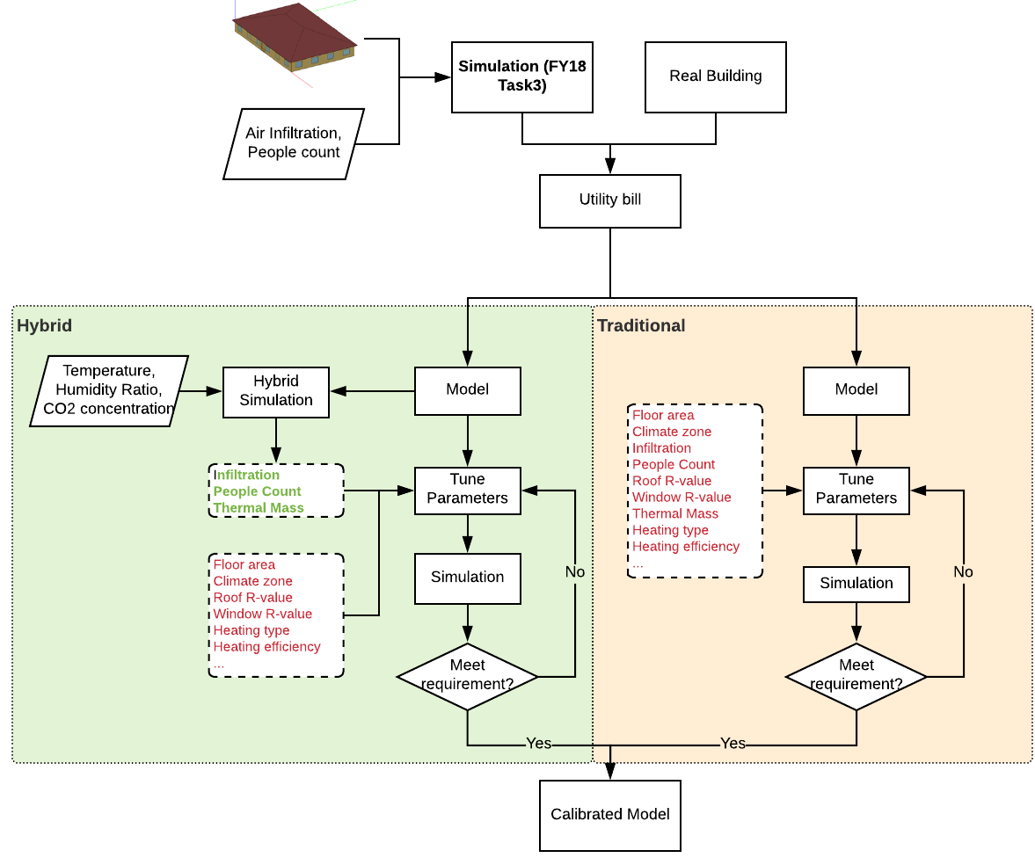
Task 3: Test the use of inversed models in the model calibration process
Compare:
Numbers of unknown parameters
Numbers of iterations
Calibrated model accuracy (ASHRAE G14)
Cases:
Manual
Hybrid
CBES’s automatic

Slide 4
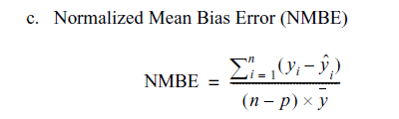

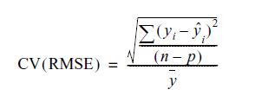
Success Criteria
Model uncertainty criteria (ASHRAE Guideline 14)
Normalized Mean Bias Error (NMBE )
Coefficient of Variation of the Root-Mean-Square-Error (CV[RMSE])
According to ASHRAE Guideline 14: “The computer model shall have an NMBE of 5% and a CV(RMSE) of 15% relative to monthly calibration data.”

Slide 5
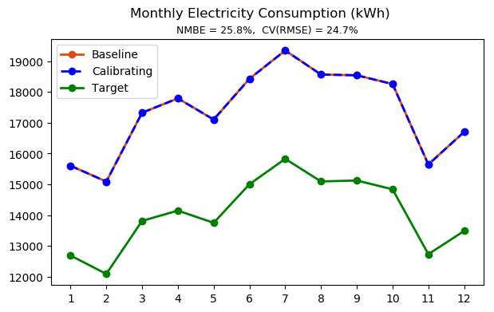
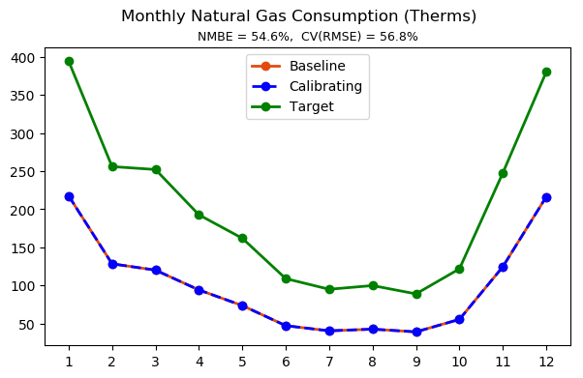
Case 1 - Manual Calibration - Initial State

Slide 6
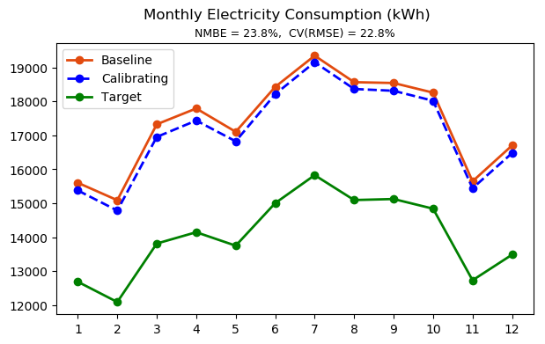
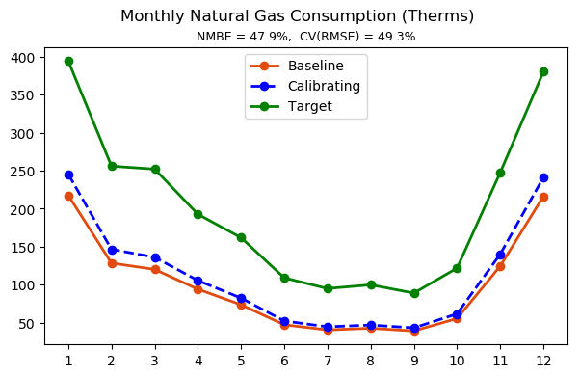
Case 1 - Manual Calibration
Exterior wall and floor thermal conductivity x 2

Slide 7
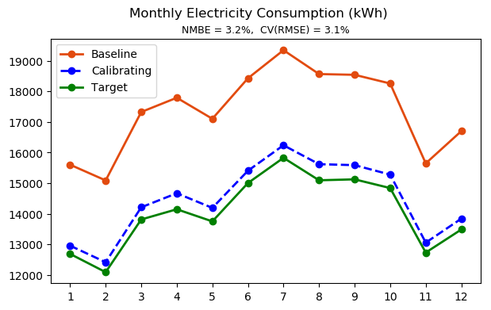
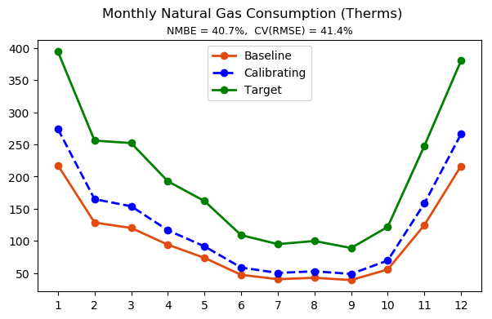
Case 1 - Manual Calibration
Exterior wall and floor thermal conductivity x 2
Interior lighting power density (21.39 W/m²) x 0.8
Interior equipment power density (14.68 W/m²) x 0.8

Slide 8
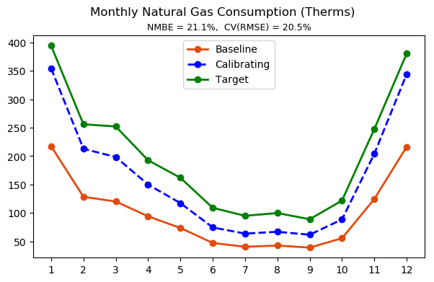
Case 1 - Manual Calibration
Exterior wall and floor thermal conductivity x 2
Interior lighting power density (21.39 W/m²) x 0.8
Interior equipment power density (14.68 W/m²) x 0.8
Reduce boiler and water heater efficiency from 0.78 to 0.6

Slide 9
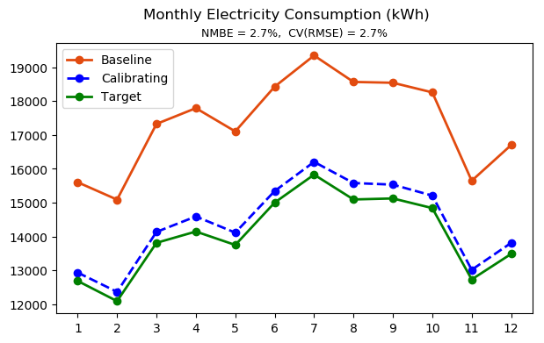
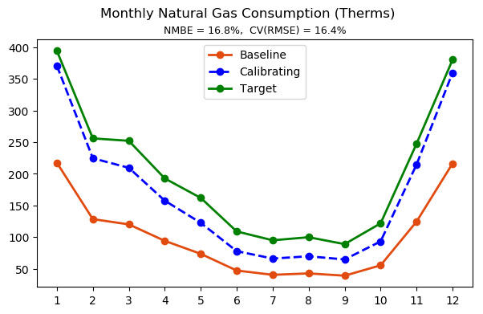
Case 1 - Manual Calibration
Exterior wall and floor thermal conductivity x 2
Interior lighting power density (21.39 W/m²) x 0.8
Interior equipment power density (14.68 W/m²) x 0.8
Reduce boiler and water heater efficiency from 0.78 to 0.6
Exterior wall and floor thickness x 0.8

Slide 10
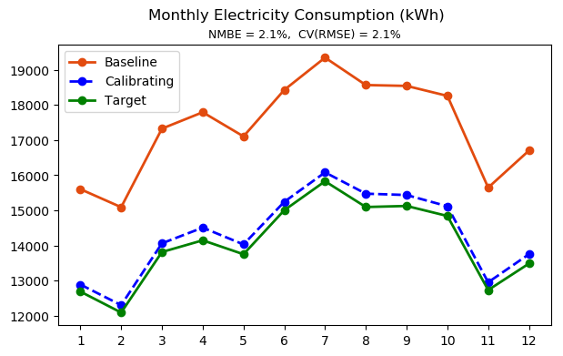

Case 1 - Manual Calibration
Exterior wall and floor thermal conductivity x 2
Interior lighting power density (21.39 W/m²) x 0.8
Interior equipment power density (14.68 W/m²) x 0.8
Reduce boiler and water heater efficiency from 0.78 to 0.6
Exterior wall and floor thickness x 0.8
Occupancy density x 0.9

Slide 11
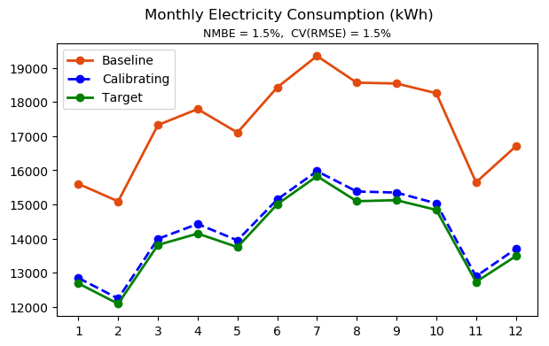
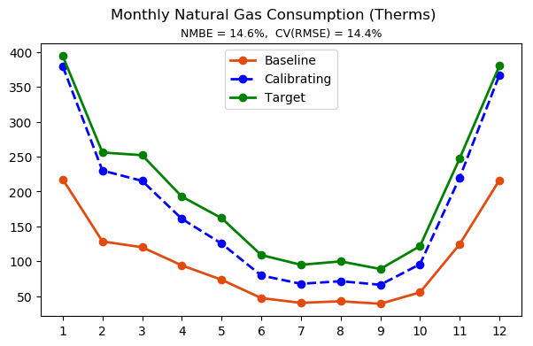
Case 1 - Manual Calibration
Exterior wall and floor thermal conductivity x 2
Interior lighting power density (21.39 W/m²) x 0.8
Interior equipment power density (14.68 W/m²) x 0.8
Reduce boiler and water heater efficiency from 0.78 to 0.6
Exterior wall and floor thickness x 0.8
Occupancy density x 0.8

Slide 12
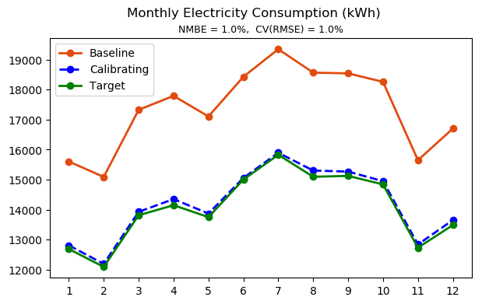
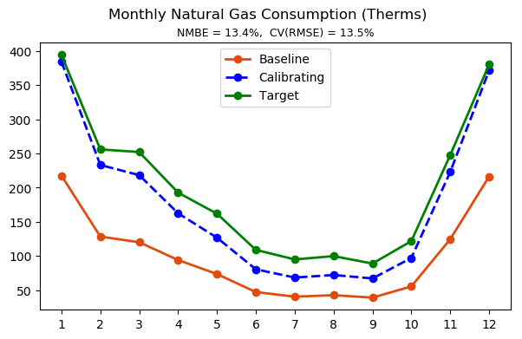
Case 1 - Manual Calibration
Exterior wall and floor thermal conductivity x 2
Interior lighting power density (21.39 W/m²) x 0.8
Interior equipment power density (14.68 W/m²) x 0.8
Reduce boiler and water heater efficiency from 0.78 to 0.6
Exterior wall and floor thickness x 0.8
Occupancy density x 0.7

Slide 13
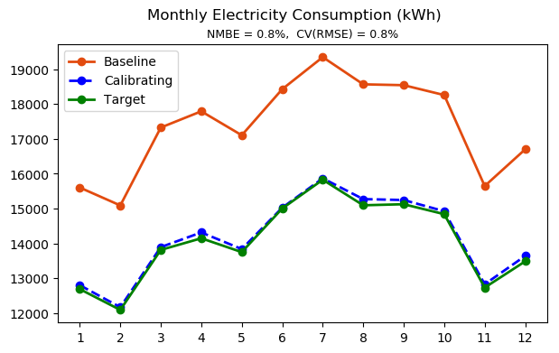
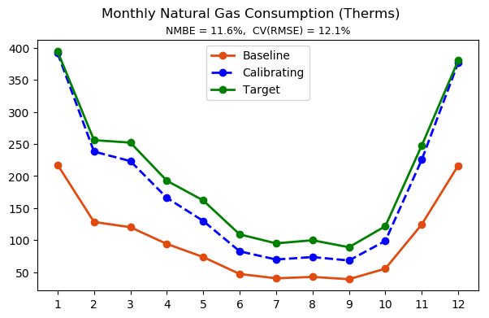
Case 1 - Manual Calibration
Exterior wall and floor thermal conductivity x 2.5
Interior lighting power density (21.39 W/m²) x 0.8
Interior equipment power density (14.68 W/m²) x 0.8
Reduce boiler and water heater efficiency from 0.78 to 0.6
Exterior wall and floor thickness x 0.8
Occupancy density x 0.7
Infiltration flow per exterior surface x 1.5

Slide 14
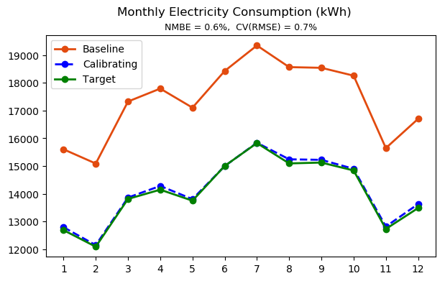
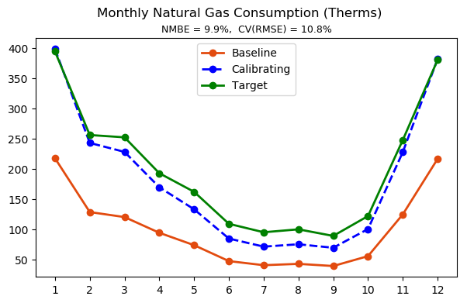
Case 1 - Manual Calibration
Exterior wall and floor thermal conductivity x 2.5
Interior lighting power density (21.39 W/m²) x 0.8
Interior equipment power density (14.68 W/m²) x 0.8
Reduce boiler and water heater efficiency from 0.78 to 0.6
Exterior wall and floor thickness x 0.8
Occupancy density x 0.7
Infiltration flow per exterior surface x 2

Slide 15
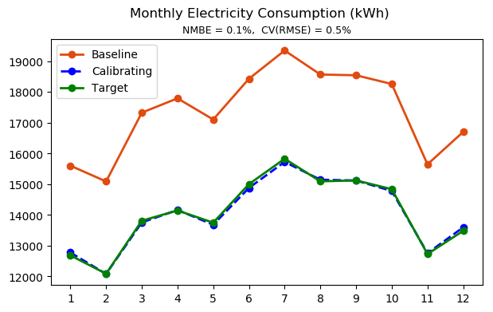
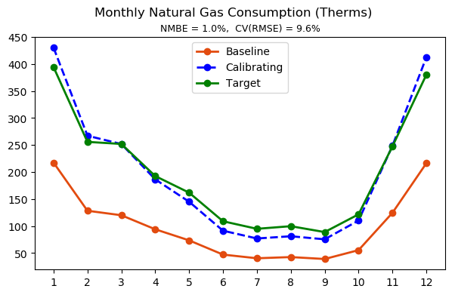
Case 1 - Manual Calibration
Exterior wall and floor thermal conductivity x 3
Interior lighting power density (21.39 W/m²) x 0.8
Interior equipment power density (14.68 W/m²) x 0.8
Reduce boiler and water heater efficiency from 0.78 to 0.6
Exterior wall and floor thickness x 0.8
Occupancy density x 0.7
Infiltration flow per exterior surface x 2

Slide 16
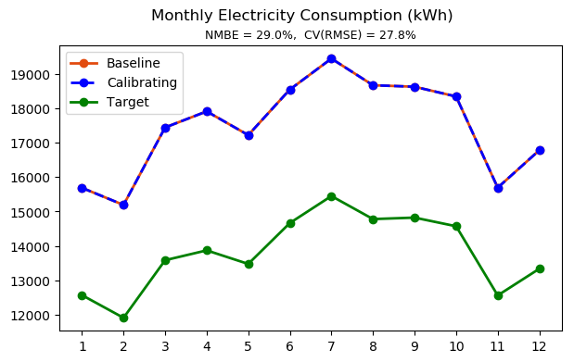
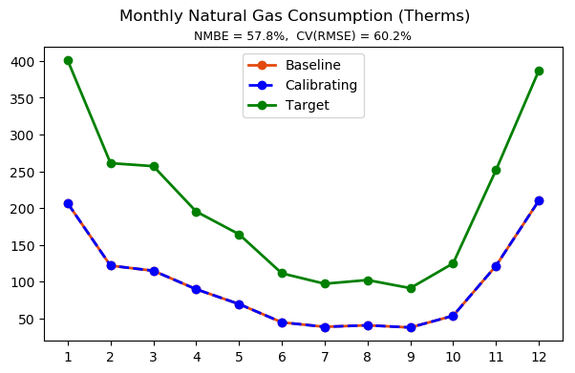
Case 2 - Hybrid Calibration - Initial State

Slide 17
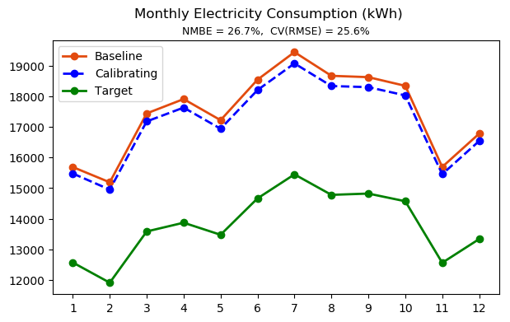
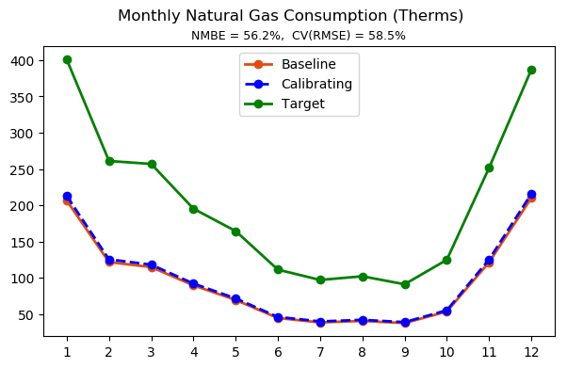
Case 2 - Hybrid Calibration
Stage 1 - Calibration with Inverse solution:
Set people count schedule from the inverse modeling solution
NMBE is reduced from 29% to 26.7%
CV(RMSE) is reduced from 27.8% to 25.6%
NMBE is reduced from 57.8% to 56.2%
CV(RMSE) is reduced from 60.2% to 58.5%

Slide 18
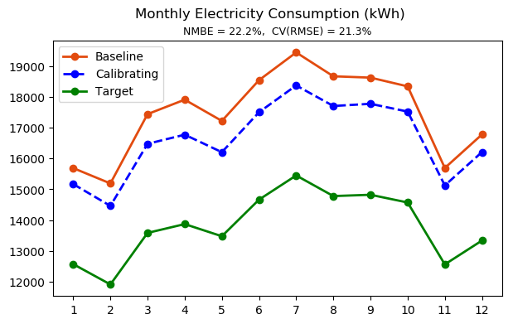
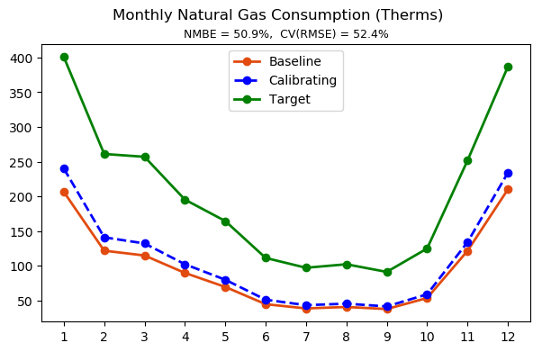
Case 2 - Hybrid Calibration
Stage 1 - Calibration with Inverse solution:
Set people count schedule from the inverse modeling solution
Set air infiltration schedule from the inverse modeling solution
NMBE is further reduced to 22.2%
CV(RMSE) is further reduced from 21.3%
NMBE is further reduced to 50.9%
CV(RMSE) is further reduced from 52.4%

Slide 19
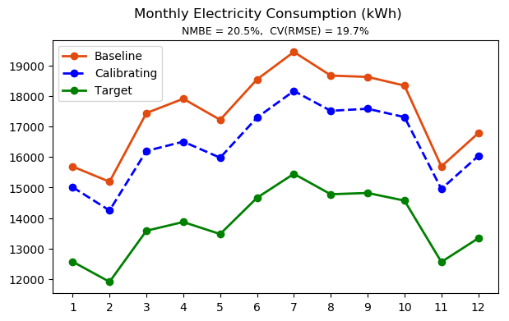
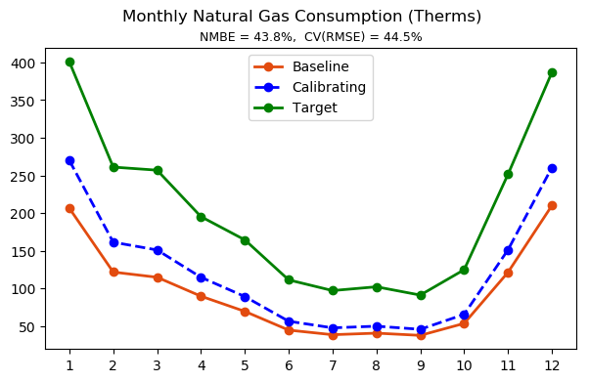
Case 2 - Hybrid Calibration
Stage 1 - Calibration with Inverse solution:
Set people count schedule from the inverse modeling solution
Set air infiltration schedule from the inverse modeling solution
Stage 2 – Conventional Calibration:
Exterior wall and floor thermal conductivity x 2

Slide 20
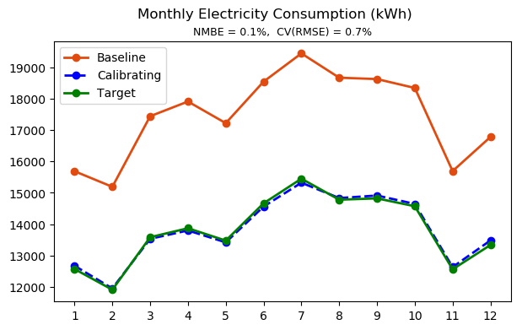
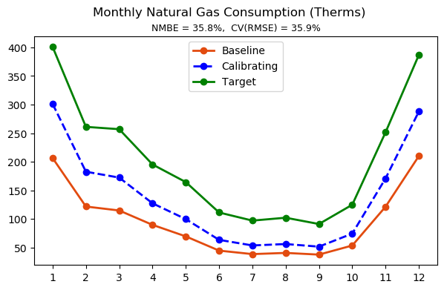
Case 2 - Hybrid Calibration
Stage 1 - Calibration with Inverse solution:
Set people count schedule from the inverse modeling solution
Set air infiltration schedule from the inverse modeling solution
Stage 2 – Conventional Calibration:
Exterior wall and floor thermal conductivity x 2
Interior lighting power density (21.39 W/m²) x 0.8
Interior equipment power density (14.68 W/m²) x 0.8

Slide 21
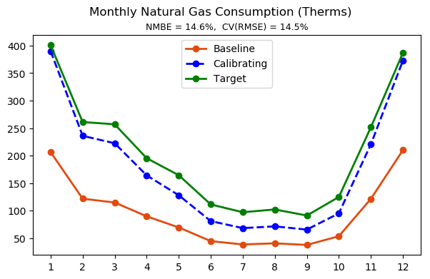
Case 2 - Hybrid Calibration
Stage 1 - Calibration with Inverse solution:
Set people count schedule from the inverse modeling solution
Set air infiltration schedule from the inverse modeling solution
Stage 2 – Conventional Calibration:
Exterior wall and floor thermal conductivity x 2
Interior lighting power density (21.39 W/m²) x 0.8
Interior equipment power density (14.68 W/m²) x 0.8
Reduce boiler and water heater efficiency from 0.78 to 0.6

Slide 22
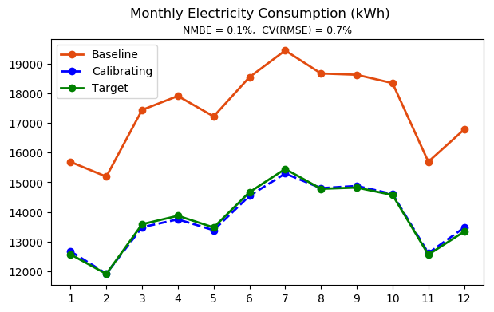

Case 2 - Hybrid Calibration
Stage 1 - Calibration with Inverse solution:
Set people count schedule from the inverse modeling solution
Set air infiltration schedule from the inverse modeling solution
Stage 2 – Conventional Calibration:
Exterior wall and floor thermal conductivity x 2
Interior lighting power density (21.39 W/m²) x 0.8
Interior equipment power density (14.68 W/m²) x 0.8
Reduce boiler and water heater efficiency from 0.78 to 0.6
Exterior wall and floor thickness x 0.8

Slide 23
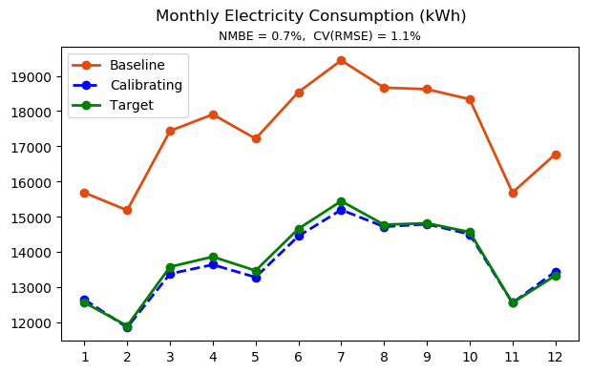
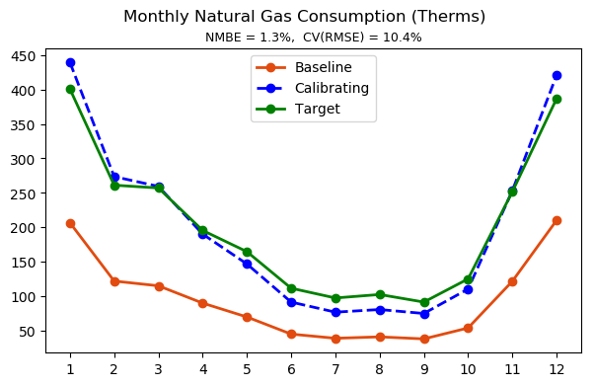
Case 2 - Hybrid Calibration
Stage 1 - Calibration with Inverse solution:
Set people count schedule from the inverse modeling solution
Set air infiltration schedule from the inverse modeling solution
Stage 2 – Conventional Calibration:
Exterior wall and floor thermal conductivity x 3
Interior lighting power density (21.39 W/m²) x 0.8
Interior equipment power density (14.68 W/m²) x 0.8
Reduce boiler and water heater efficiency from 0.78 to 0.6
Exterior wall and floor thickness x 0.8

Slide 24
Comparison
Coomparison Metrics |  | Manual Calibration | Hybrid Calibration | CBES (Simple) | CBES (Detailed)
NMBE | Electricity | 0.1% | 0.7%
 | Natural Gas | 0.5% | 1.1%
CV(RMSE) | Electricity | 1.0% | 1.3%
 | Natural Gas | 9.6% | 10.4%
Steps |  | 10 | 6
Data requirements |  | Building geometry, weather data, building system information, operation schedules | Building geometry, weather data, building system information, operation schedules, zone and supply air parameters | Building floor area, location, monthly utility data
Summary |  | Requires expertise in building energy modeling. The calibration process is highly uncertain as many factors can affect the energy consumption. Calibrated model may not necessarily represent the dynamics in real building. | Requires expertise in building energy modeling. Requires extensive preparations (measurements of room air parameters and inverse modeling of the people count and air infiltration rate). The calibration process is less uncertain since highly dynamic and unknown parameters like people count and air infiltration are determined. | Does not converge

